Slide 1













Slide 2
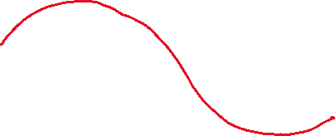
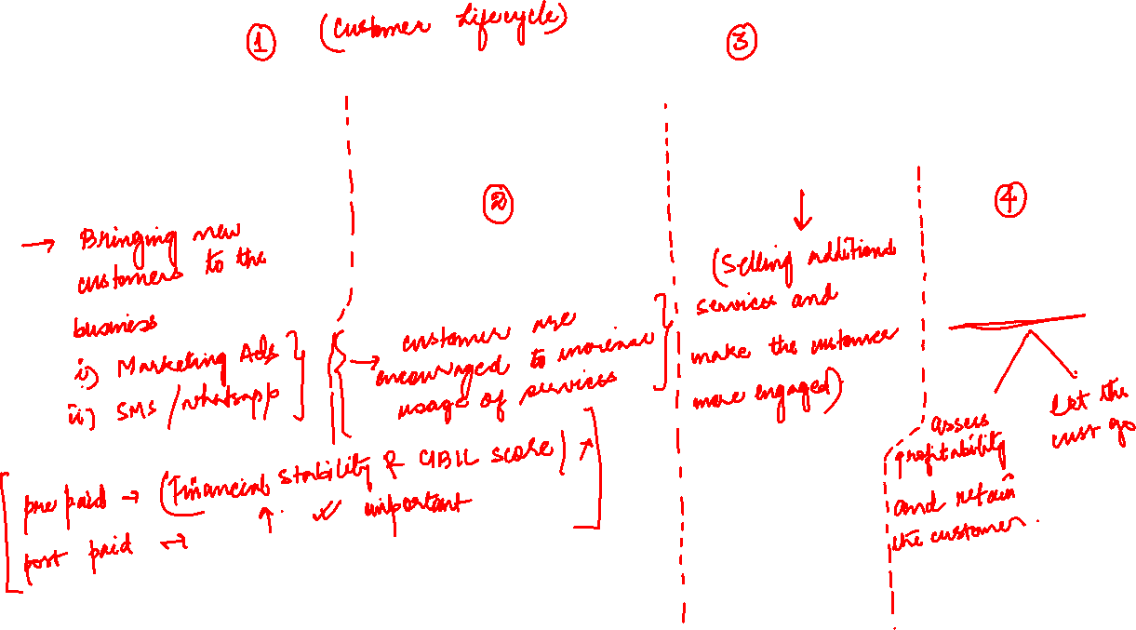
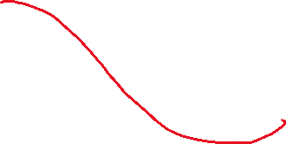

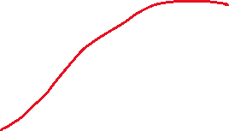

Slide 3
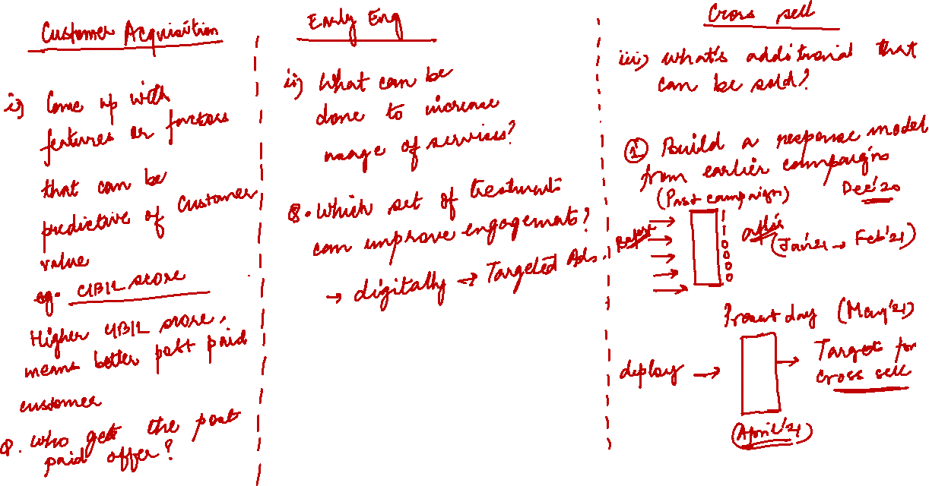
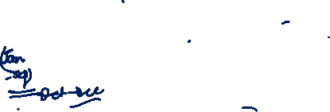

Slide 4
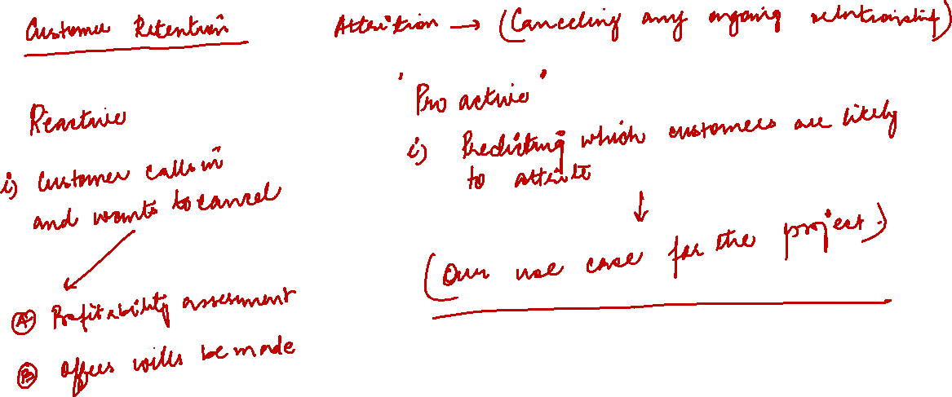
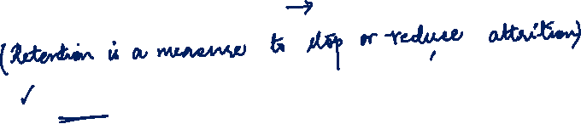

Slide 5
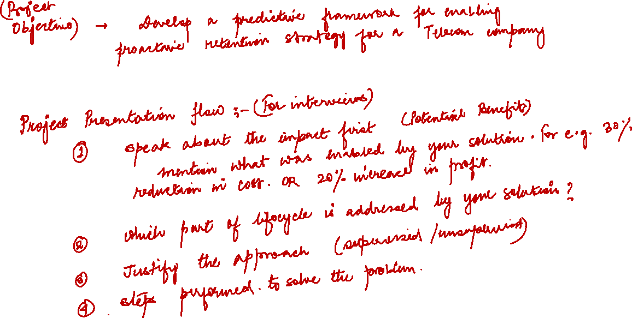


Slide 6










Slide 7
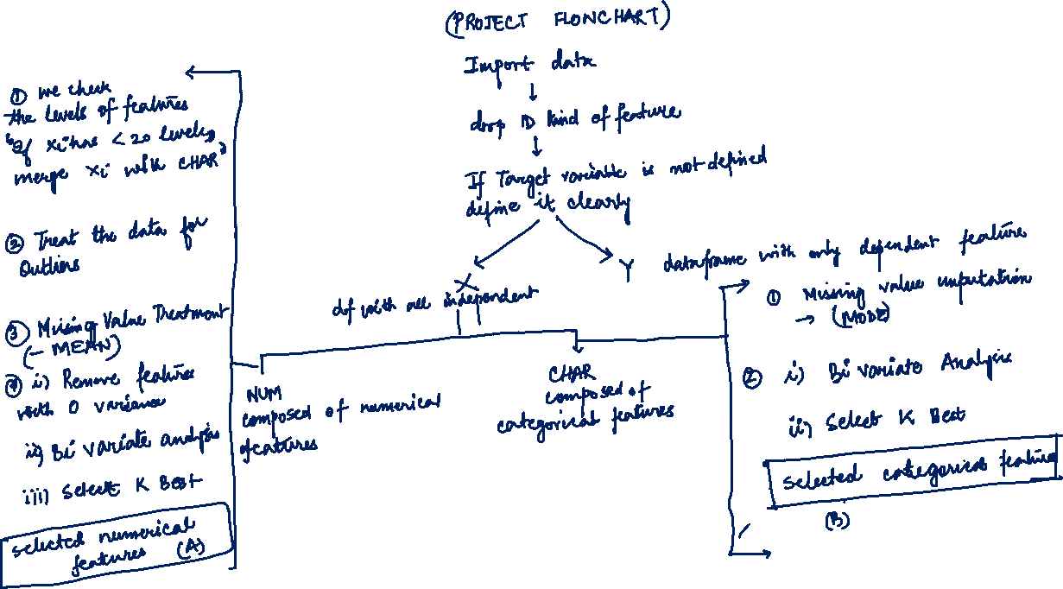



Slide 8
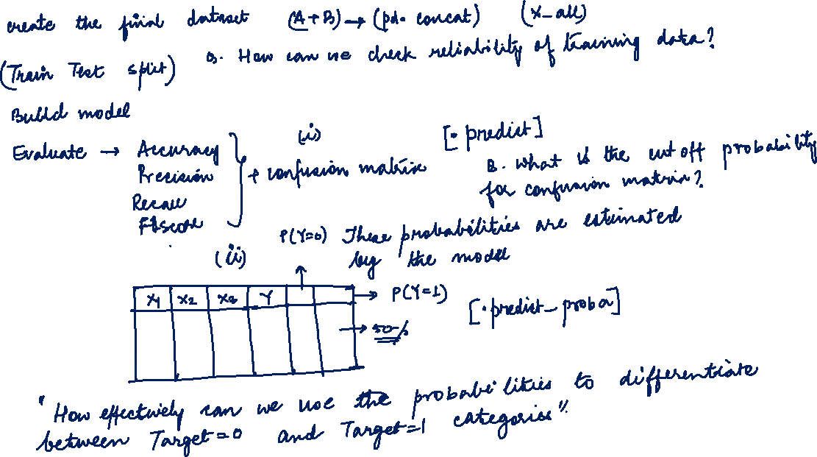


Slide 9
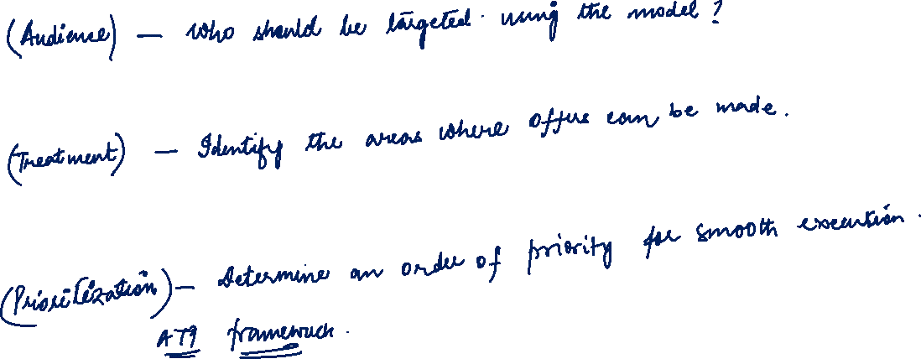

Slide 10
Probability 50% cut off logic
X1 | X2 | Y | P(Y=0) | P(Y=1) | Predicted Target with 50% cutoff
10 | 15 | 1 | 0.3 | 0.7 | 1
15 | 15 | 1 | 0.45 | 0.55 | 1
22 | 17 | 0 | 0.7 | 0.3 | 0
23 | 17 | 0 | 0.51 | 0.49 | 0
17 | 17 | 0 | 0.2 | 0.8 | 1
18 | 17 | 0 | 0.1 | 0.9 | 1
22 | 16 | 1 | 0.65 | 0.35 | 0

Slide 11
Missing Value Imputation for Numerical Features
from sklearn.impute import SimpleImputer
imputer = SimpleImputer(missing_values=np.nan, strategy='mean')
num_1=pd.DataFrame(imputer.fit_transform(num),index=num.index,columns=num.columns)
Missing Value Imputation for Categorical Features
from sklearn.impute import SimpleImputer
imputer = SimpleImputer(missing_values=np.nan, strategy=‘most frequent')
char_1=pd.DataFrame(imputer.fit_transform(char),index=char.index,columns=char.columns

Slide 12
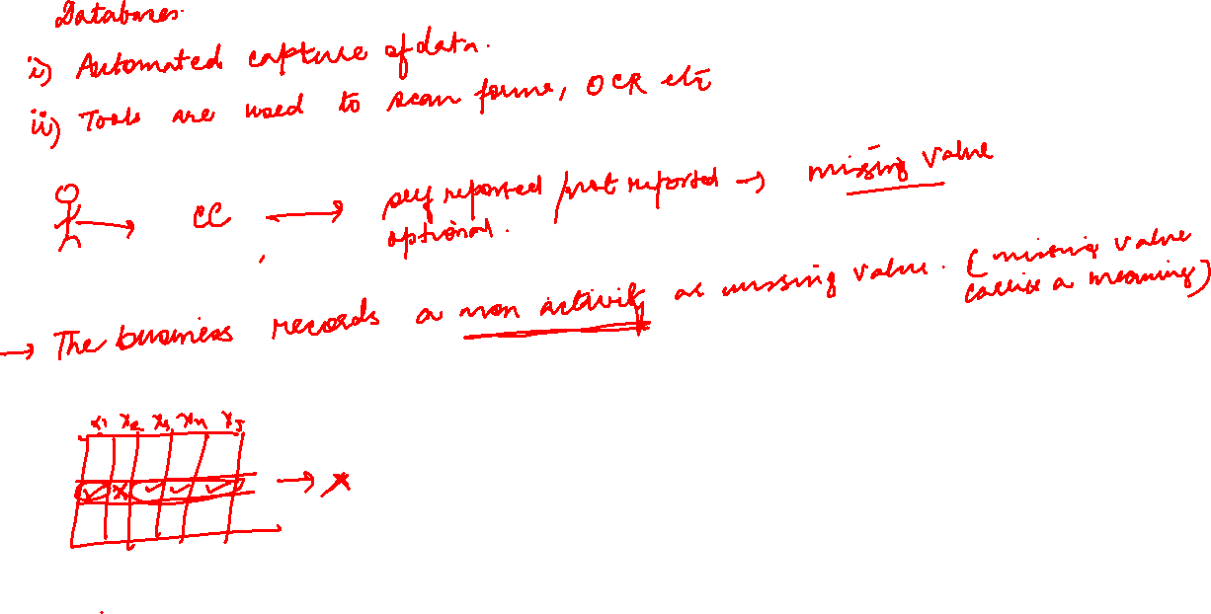

Slide 13
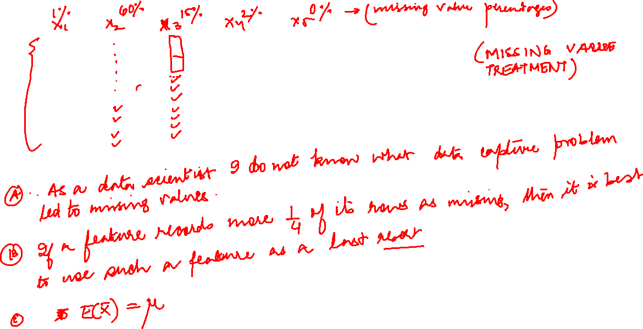

Slide 14
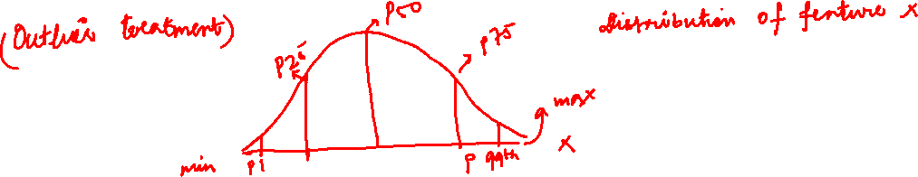

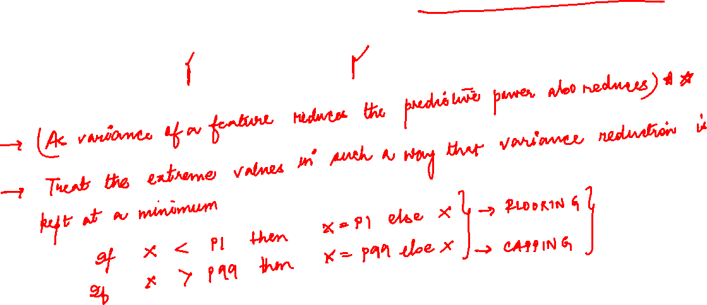

Slide 16
